Slide 1
Project- CAR PRICE PREDICTION MODEL
By-
ASHISH KUMAR SAMAL

Slide 2

BUSINESS PROBLEM FRAMING
Data source of Used Cars from different websites like OLX,drooms,cars24 etc.
Predicting price of a used car using given features.
Acts like a Price predicting tool.
Collaboration with individuals,used car dealers etc
Based on Budget Operator model.

Slide 3
Background of the Domain Problem
Vehicle price prediction especially when the vehicle is used and not coming direct from the factory, is both a critical and important task.
With increase in demand for used cars more and more vehicle buyers are finding alternatives of buying new cars.
There is a need of accurate price prediction mechanism for the used cars.
Prediction techniques of machine learning can be helpful in this regard.
It is common to lease a car in many countries rather then buying a new car

Slide 4
Review of Literature
A car price prediction has been a high interest research area, as it requires noticeable effort and knowledge of the field expert.
Considerable number of distinct attributes are examined for the reliable and accurate prediction.
To build a model for predicting the price of used cars the applied four machine learning techniques like DecisionTree,kneighbors,AdaBoost and linear regression..

Slide 5
Data Sources and their Formats
9 Columns
5011 Rows
No Null Values
2 columns of int64
3 columns of Object
4 columns of Float64

Slide 6
Hardware and Software Tools
Laptop
Numpy
Pandas
Imblearn
Seaborn
Matplotlib
Sklearn
Phone
Jupyter
Youtube
Github

Slide 7
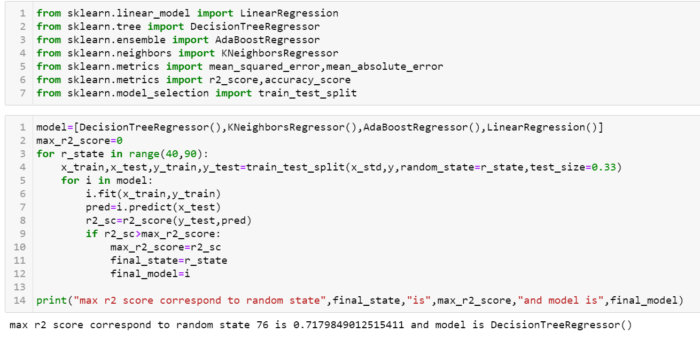
Models’ Development & Evaluation

Slide 8
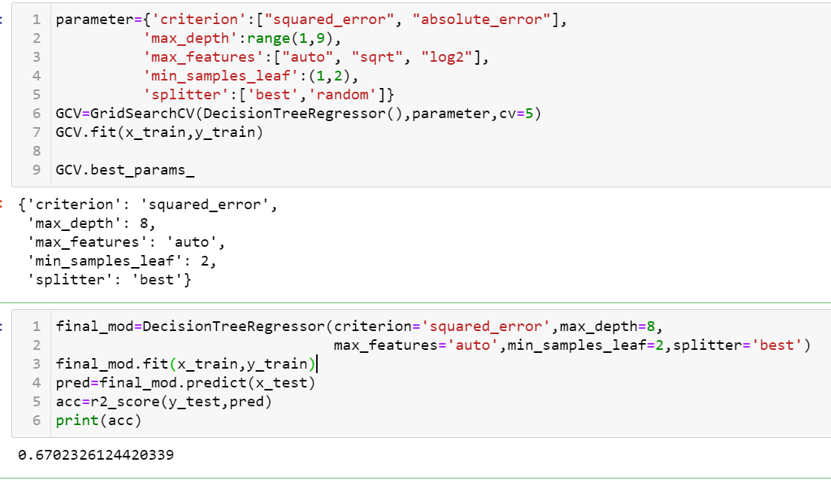
Testing of Identified Approaches (Algorithms)

Slide 9
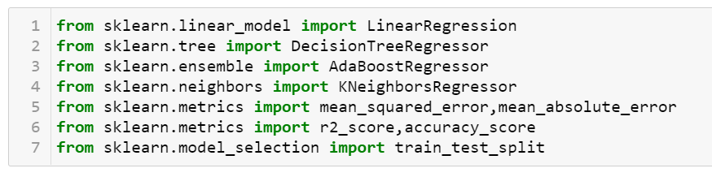
Run and Evaluate selected models
I passed 33% of dataset for testing and rest 67% for training.
Passed models and best model according to there R2_score is as:-
Decision Tree Classifier(71.0),

Slide 10
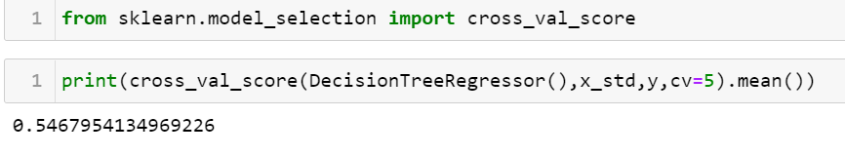
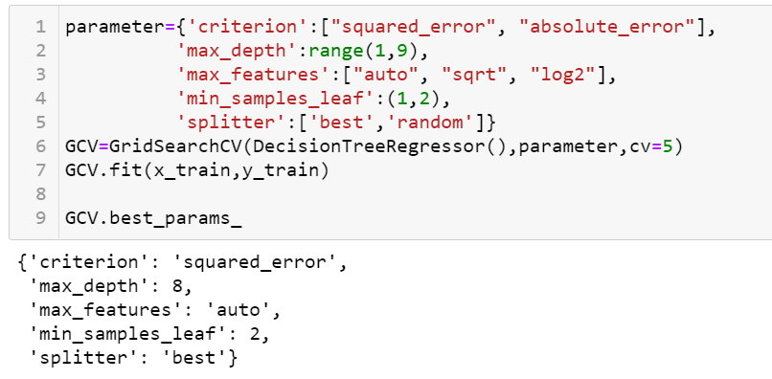
Key Metrics for success in solving problem under consideration
Cross
Validation Score
Applying GridSearchCV for our best performing model :-
RandomForestClassifier

Slide 11
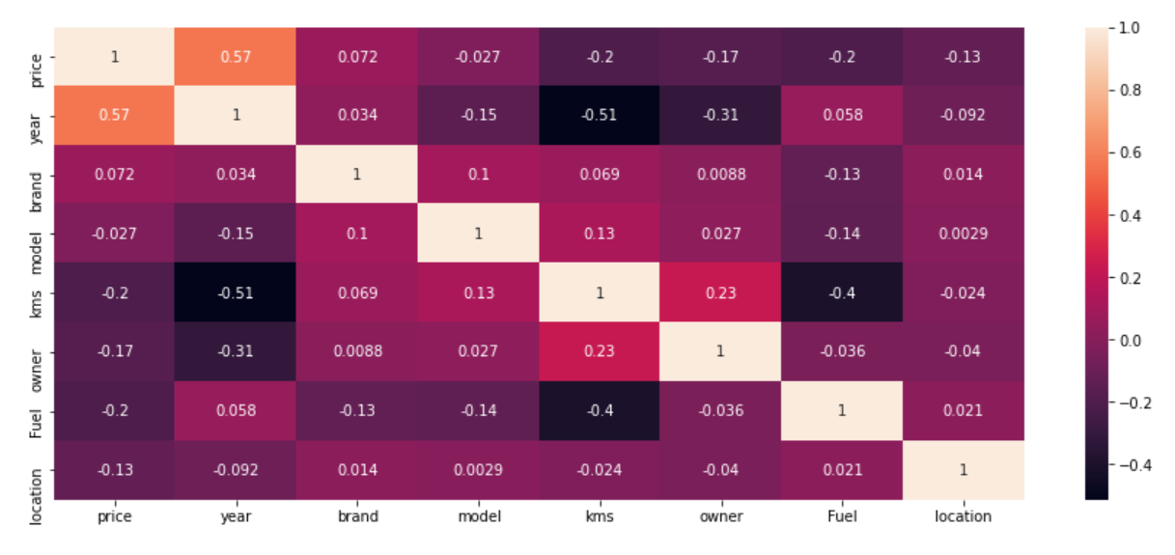
Visualizations
Correlation Matrix

Slide 12
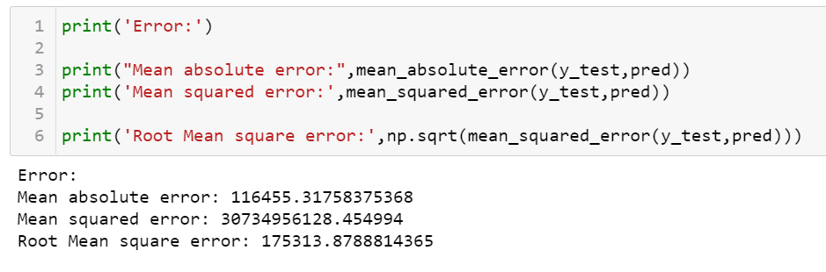
Interpretation of the Results
After cross validation and studying the metrics performance of 4 different models I arrive to the decision the DecisionTreeRegressor is giving me best results for every criteria.

Slide 13
THANKYOU
Github Link-https://github.com/Ashsam2310/Practice_Projects/

